Slide 1
DATS 6103 Project 1 Sean Pili

Slide 2
Military Spending Analysis of 10 Countries Background
Found Military Spending (2017 USD), GDP (2017 USD) and Population Data for the following countries:
China, Russia, UK, France, Germany, Italy, Iran, Saudi Arabia, Israel, S. Korea
Data Source:
WorldBank
Downloaded one dataset for each variable of interest, which contained information from 1960-2017.

Slide 3
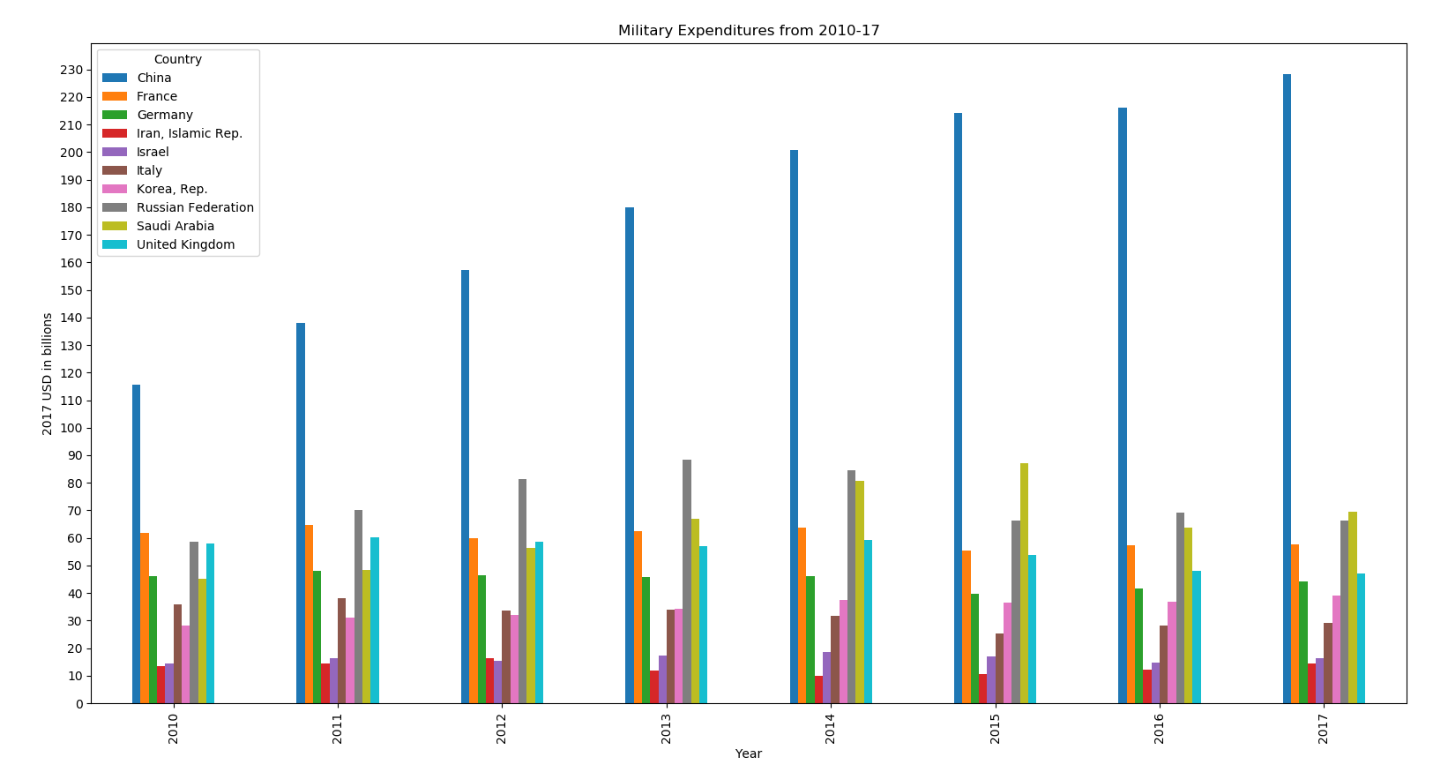
Analysis: Comparison of Military Spending
China Dominates and is steadily rising, with Saudi Arabia and Russia swapping between second place
Middle of the pack typically spends between 30-70 Billion USD
Iran spends the least almost every year (Israel, 2012) and considerably less than the other countries.

Slide 4
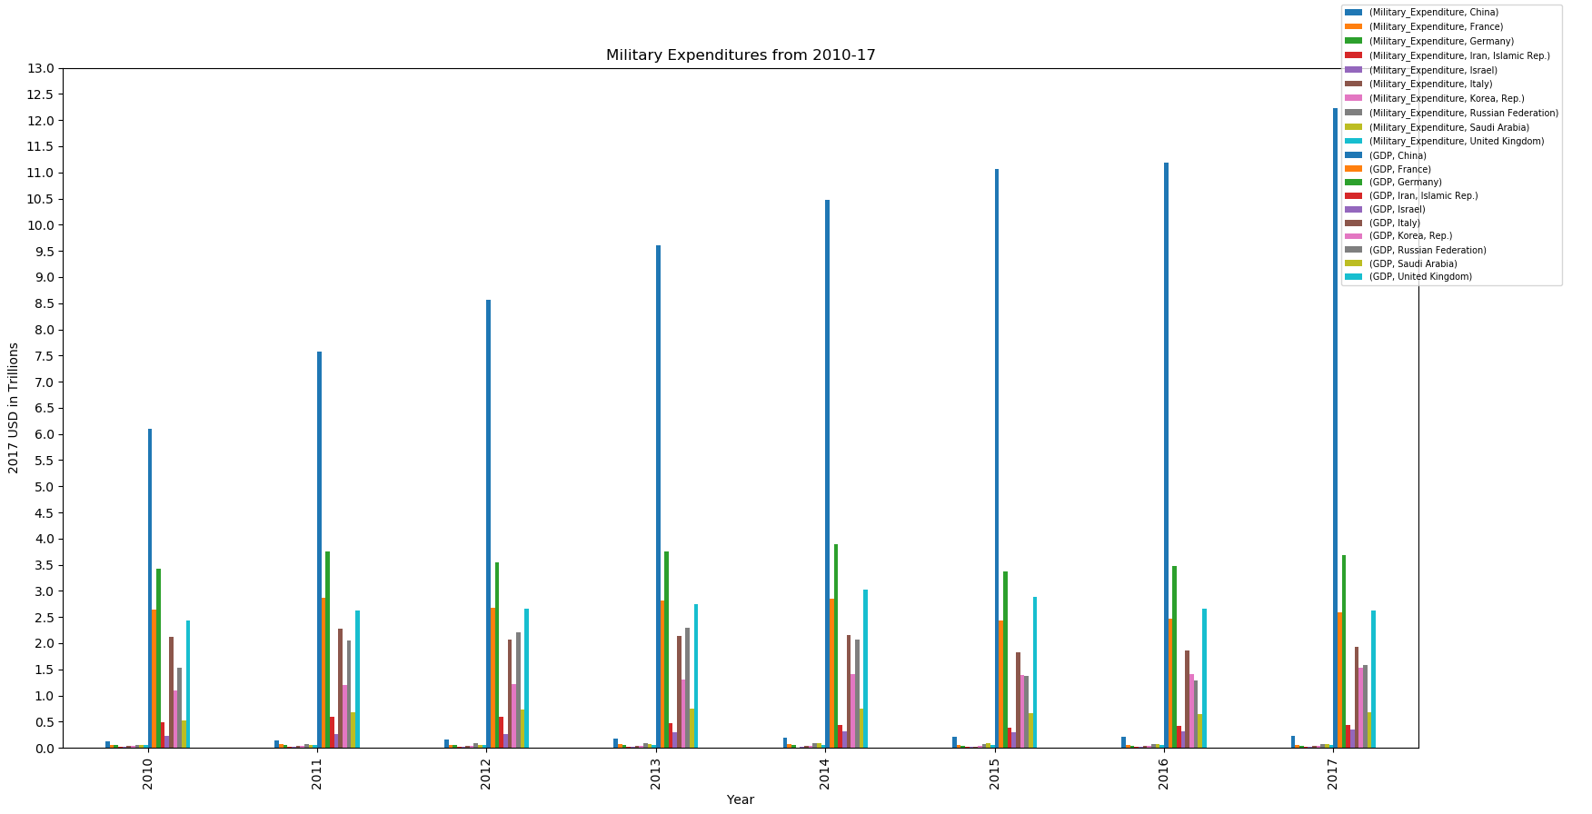
Military Spending V. GDP

Slide 5
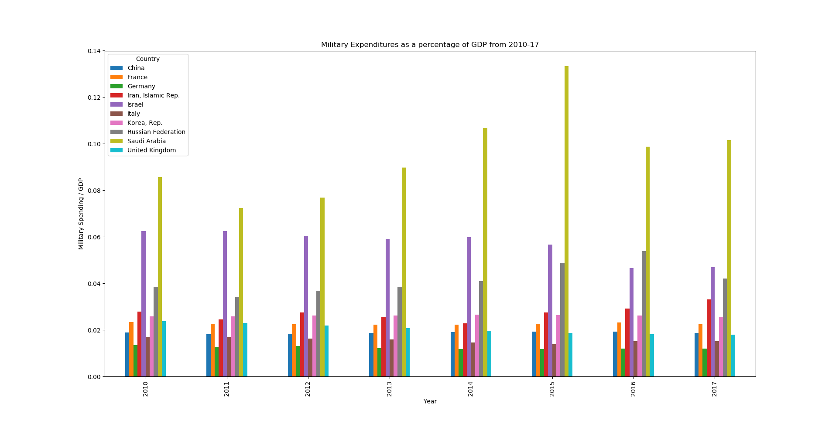
Military spending cont: Military Spending / GDP
China doesn’t dominate anymore, it spends more on military, but has a bigger economy overall
Israel spends less overall on its military than most countries but it spends more $ than most other countries proportional to its GDP
Saudi Arabia spends the most on its military proportional to its GDP

Slide 6
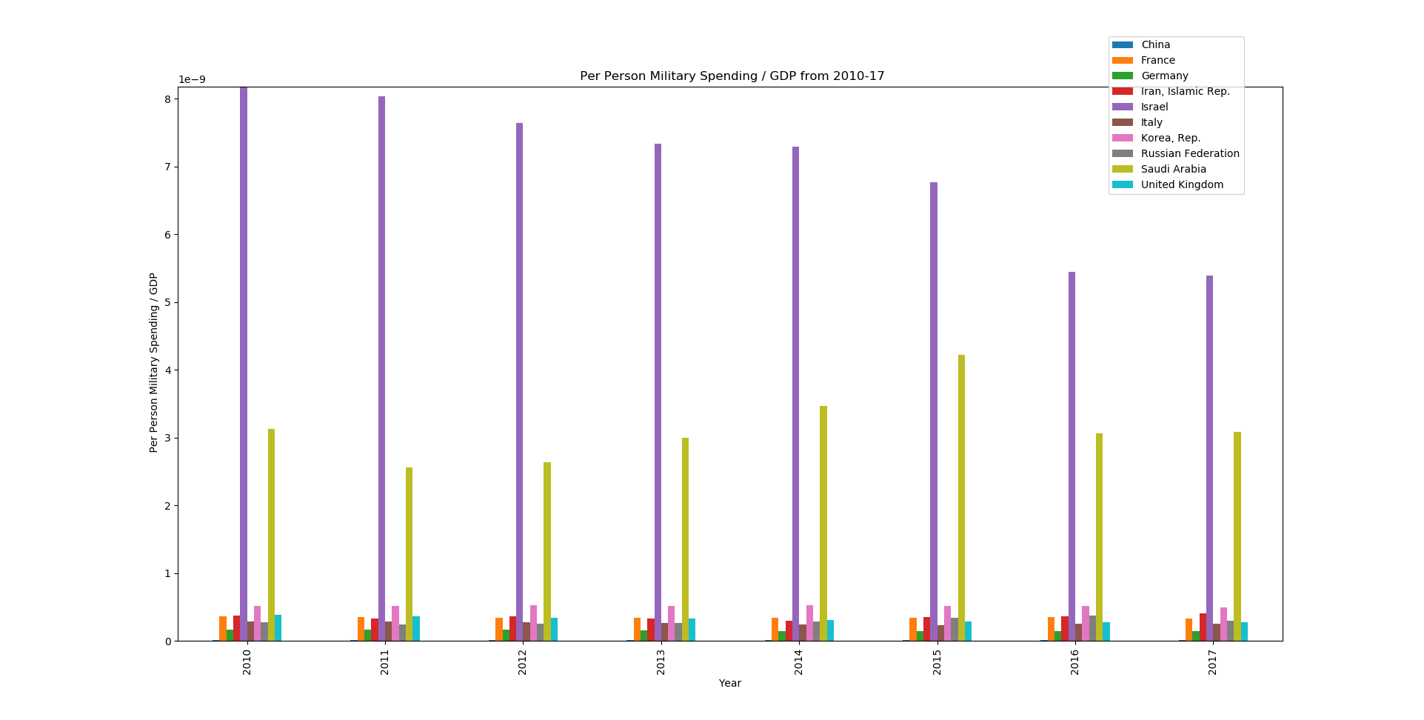
Per Person GDP v. Per Person Military Spending
China is no longer visible on the graph on the right, because they have a very large population relative to the other countries
Israel and Saudi Arabia are outliers. They switched positions from the graph on the left because Israel has a smaller population than Saudi Arabia, i.e. Israel is spending more per person, proportional to its GDP

Slide 7
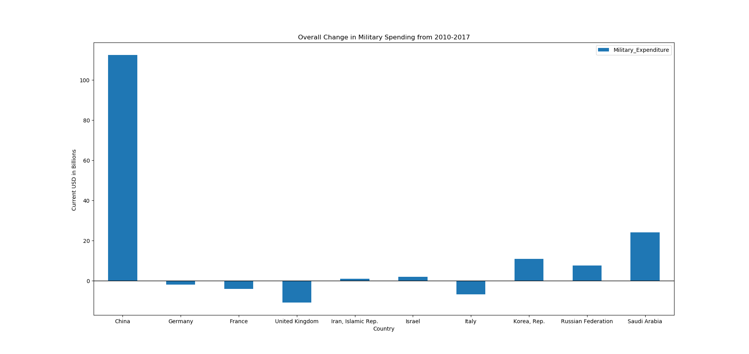
Fastest Growing Countries Fixed Dollar Military Spending
In terms of fixed dollar spending, China increased its spending the most from 2010-2017 by a total of 112.5 billion (2017) USD.
It spent over 4x as much as the next biggest spender, Saudi Arabia (24.2 billion 2017 USD.)

Slide 8
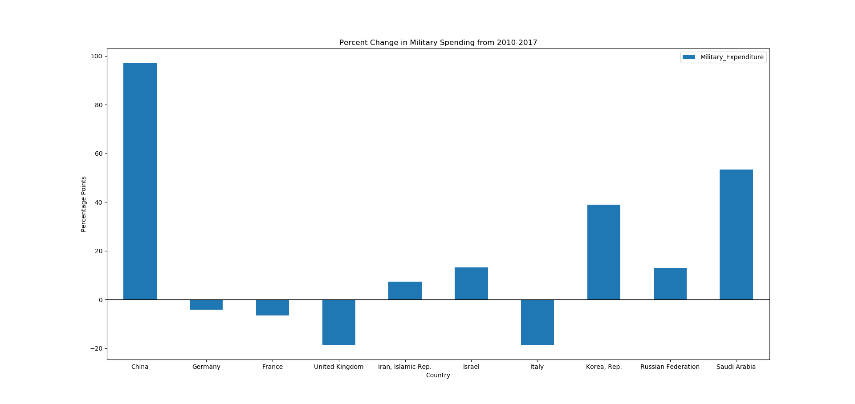
Fastest Growing Countries: Percentage Change
Percentage Change is defined as:
([2017 Military Spending – 2010 Military Spending ] /
2010 Military Spending)
China increased it’s 2010 military spending by almost 100%! (97.2%)
Saudi Arabia has the second greatest rate of change in its military spending at 53.4% followed by South Korea at 40%

Slide 9
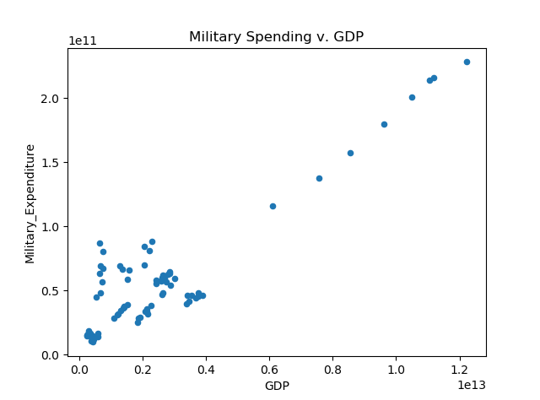
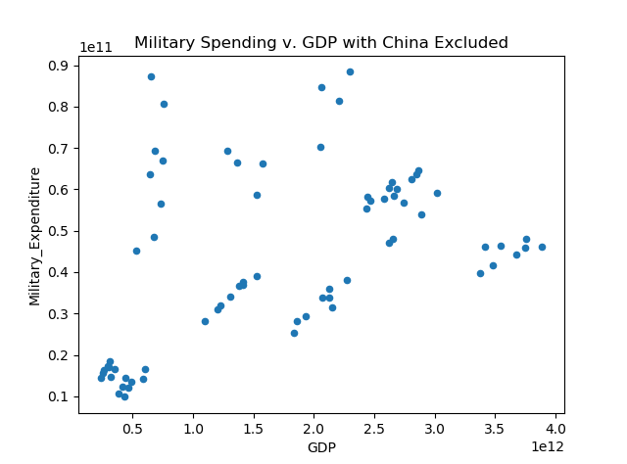
Associations: Military Spending v. GDP
Figures below are scatterplots of Military Spending (Y axis) v. GDP (X axis), the figure on the right includes all countries
Potentially a positive relationship, but there’s a lot of spread. Those 8 points that form a line look like China.
After re-plotting the data without China, there isn’t a very strong relationship, at least to the naked eye.
Clusters present in the scatterplot on the right might all belong to separate countries.

Slide 10
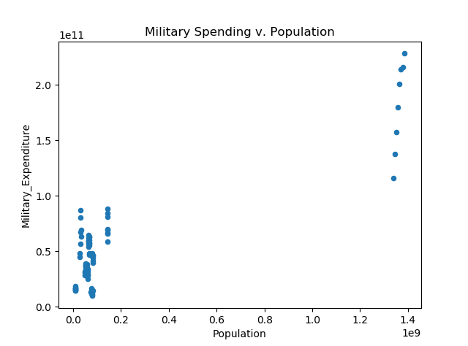
Associations: Population and Military Spending
Plot below is of Military Spending (Y axis) v. Population (X axis.)
There doesn’t really appear to be a clear relationship between the two, at least not a simple polynomial one (linear, quadratic.)

Slide 11
Conclusion: Predictions for each country’s military spending in 2018.
China: increase because it’s been doing so steadily over the years.
I expect all other countries to stay relatively the same because none of them increased seemingly every year, or by nearly as much overall.

Slide 12
Works Cited
GDP Data: https://data.worldbank.org/indicator/NY.GDP.MKTP.CD
Military Spending Data: https://data.worldbank.org/indicator/MS.MIL.XPND.CD?end=2017&start=2017&view=bar
Population Data: https://data.worldbank.org/indicator/SP.POP.TOTL

